Slide 1

Statistics for Economics, Lecture 20
jim.crozier@gatech.edu, 2023

Slide 2
Today
Introduce t-test with varying sample size and variance
Review homework 9

Slide 3
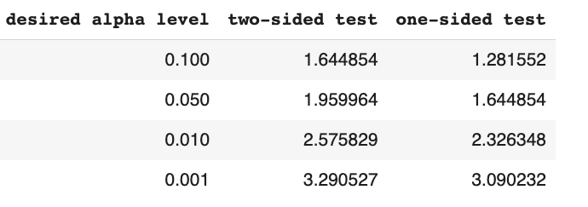

Slide 4
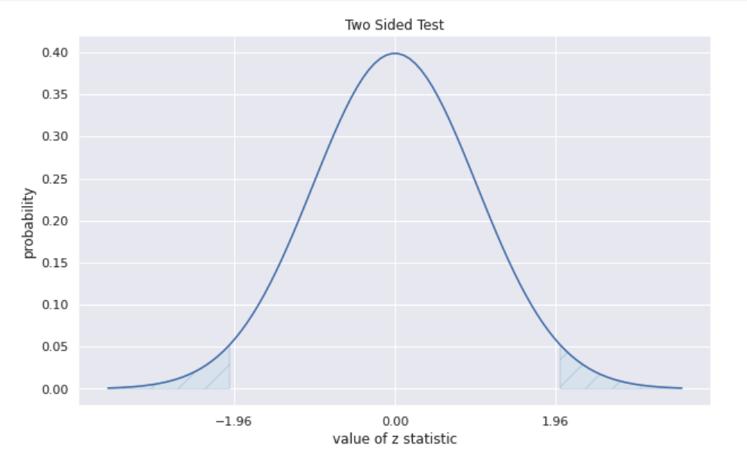

Slide 5

(simple) T Tests = z-test

Slide 6
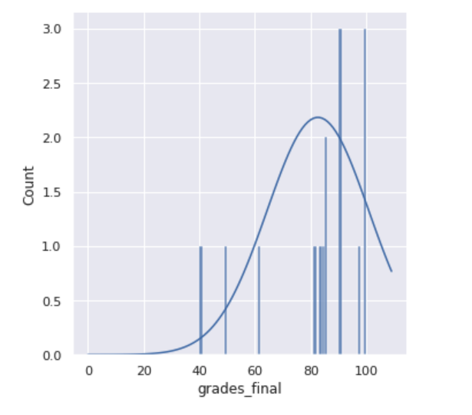
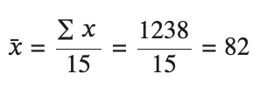
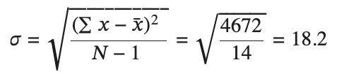

Slide 7
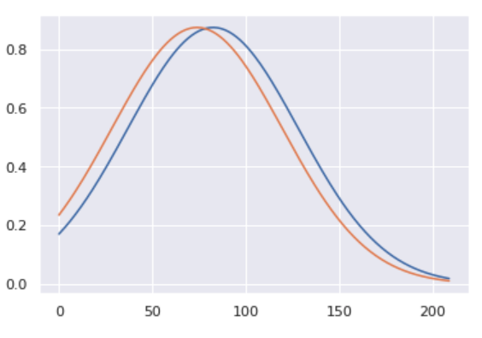
How to tell if significant difference between 2 classes?
Class1: 82 (18)
Class2: 72 (18)

Slide 8
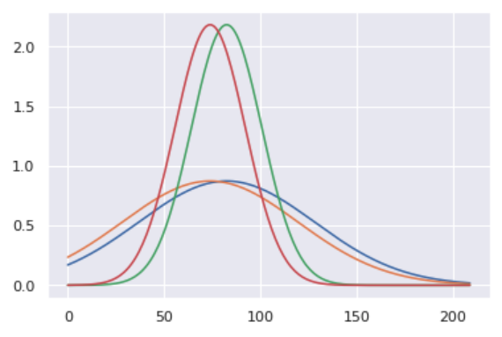
Remember, variance matters

Slide 9
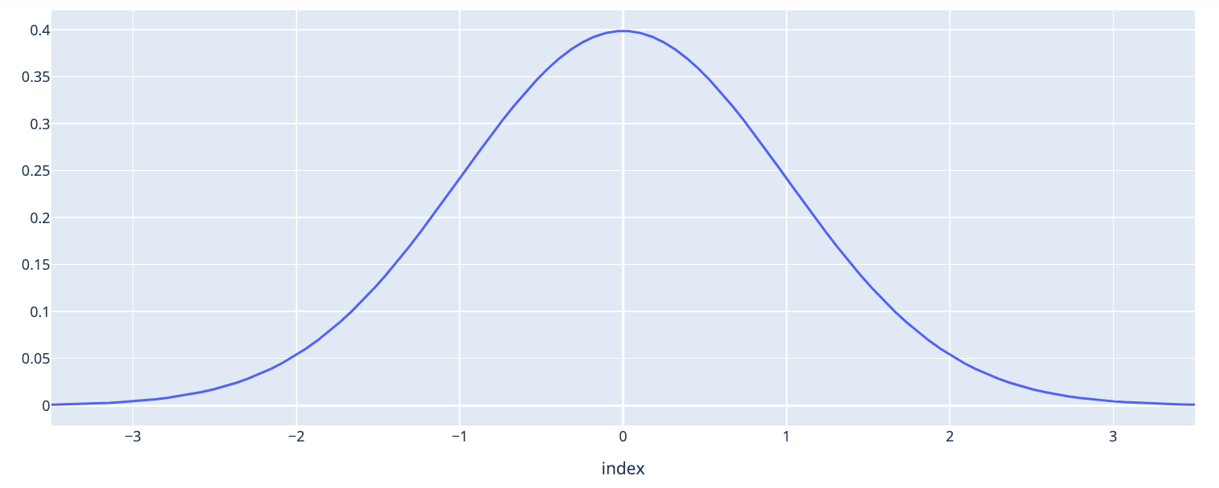
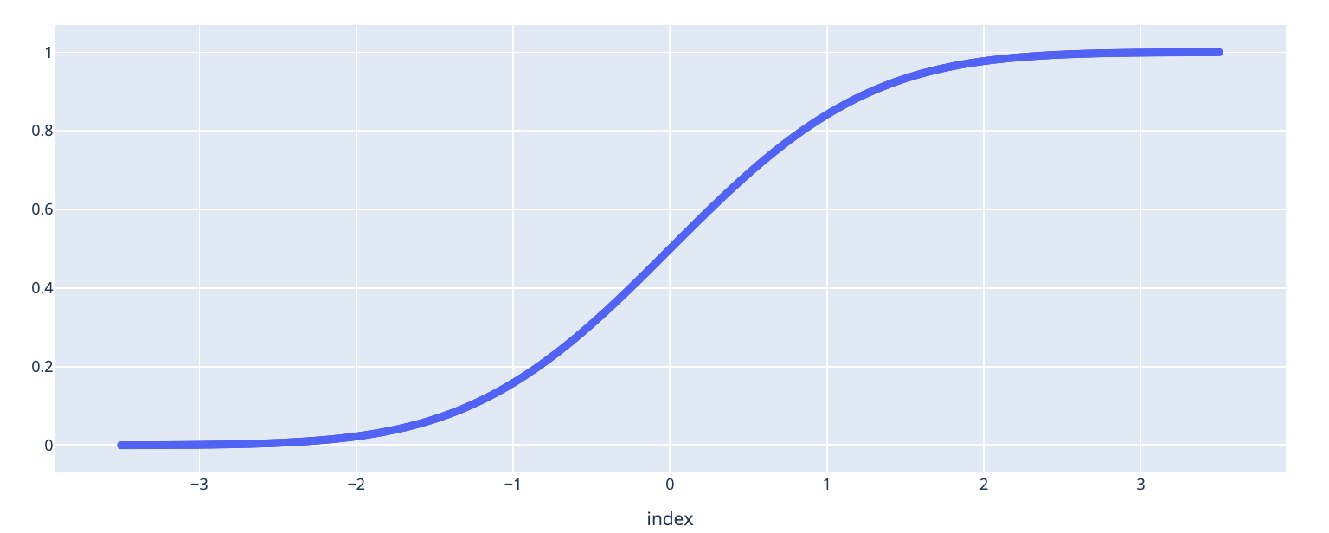

Slide 11
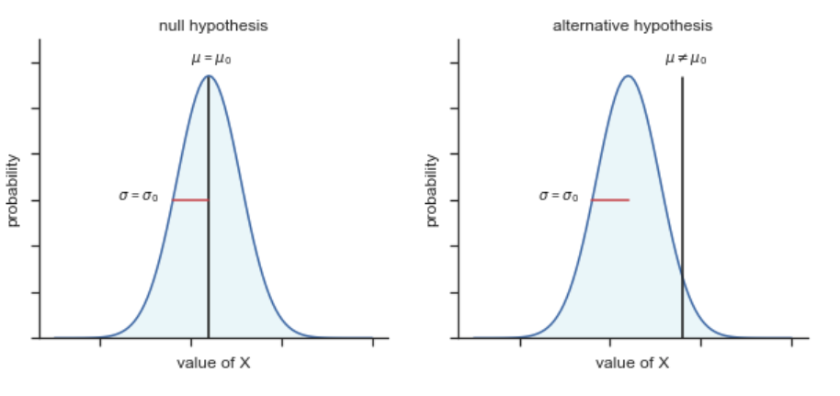

Slide 12
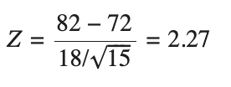
Simple T-Test Case 1
Class1: 82 (18)
Class2: 72 (18)
H0: Difference - 0
H1: Not H0

Slide 13

Simple T-Test Case 2: smaller delta
Class1: 82 (18)
Class2: 76 (18)
H0: Difference - 0
H1: Not H0

Slide 14

Simple T-Test Case 3: higher variance
Class1: 82 (28)
Class2: 72 (28)
H0: Difference - 0
H1: Not H0

Slide 16
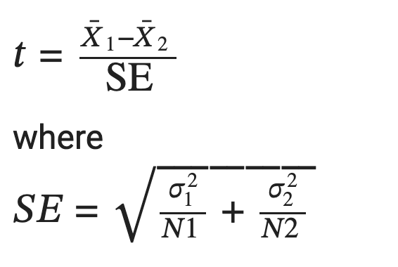
T-test

Slide 17
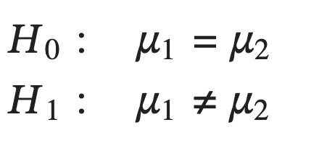
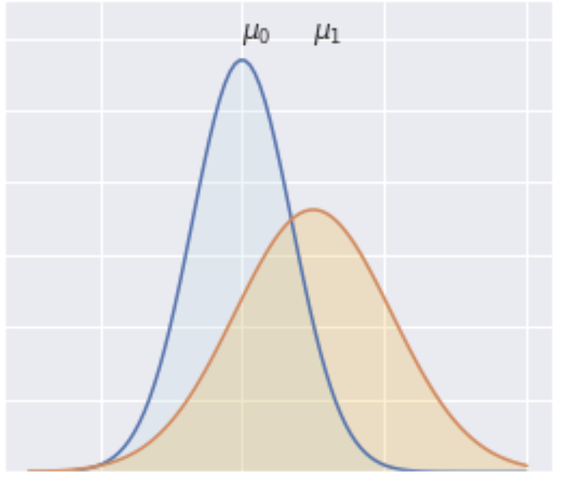
Difference between two groups with different sample sizes and variance
Classroom 1
Avg: 82
Stdev: 18
Size: 15
Classroom 2
Avg: 72
Stdev: 24
Size: 30

Slide 18
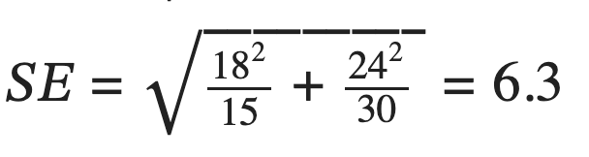
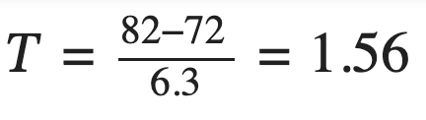
Classroom 1
Avg: 82
Stdev: 18
Size: 15
Classroom 2
Avg: 72
Stdev: 22
Size: 24

